Slide 1
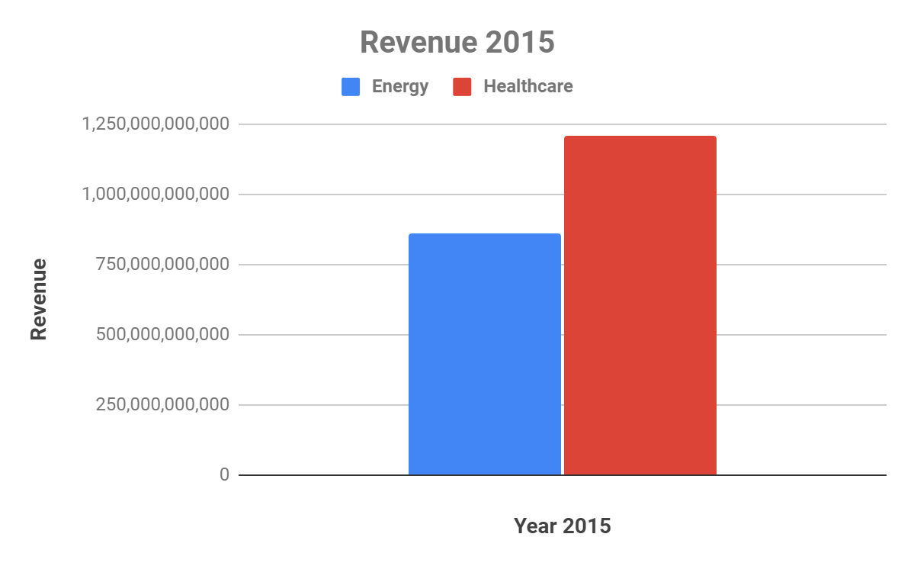
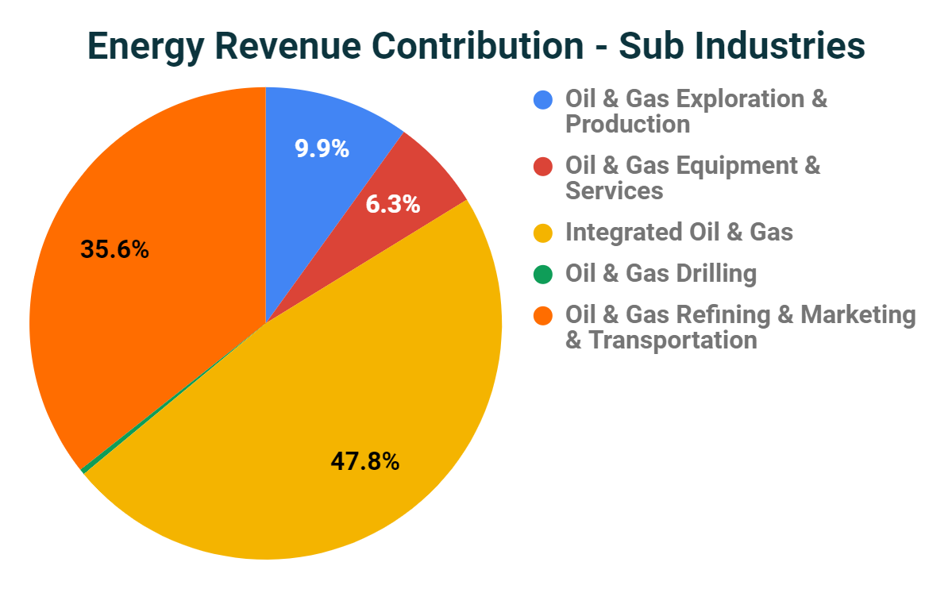
In Year 2015, among Energy and Healthcare sector, which did well in terms of revenue, and which sub-industries are the top contributors in Energy sector
Graph1
Graph 1 : Shows the revenue comparison of Energy and Healthcare sectors in Year 2015
Mean is greater than Median for both sectors. Hence, the data is right skewed.
StdDev and Range for Energy Sector is higher than Healthcare Sector indicating higher variability/spread whereas the Overall revenue for Healthcare is more.
While the Overall revenue of Healthcare is higher (1,205,934,822,000 vs 861,802,498,000), the range of Energy sector is high (258,306,296,000 vs indicating
Graph 2 : Integrated Oil & Gas and Oil & Gas Refining & Marketing & Transportation jointly contribute to >80% of the revenue in Energy Sector.
The sub-industry revenue indicates higher revenue from downstream services with equally high operating cost. (Operating Cost : 169,507,946,000 Vs 89,131,391,000)
Graph 2
Link to the Spreadsheet

